Slide 1

Walmart Sales Analysis:
This presentation explores key findings from our data analysis project focused on Walmart sales data. We will uncover insights on top branches, profitable product lines, customer segmentation, and more.
By: Ayush Kumar

Slide 2
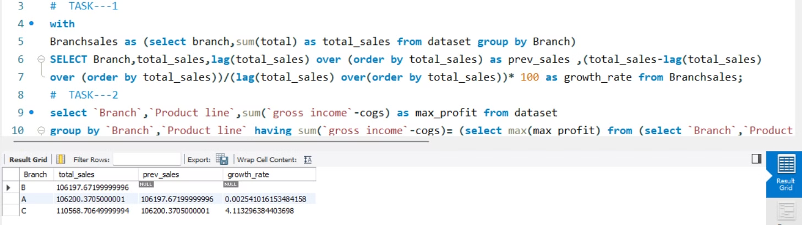
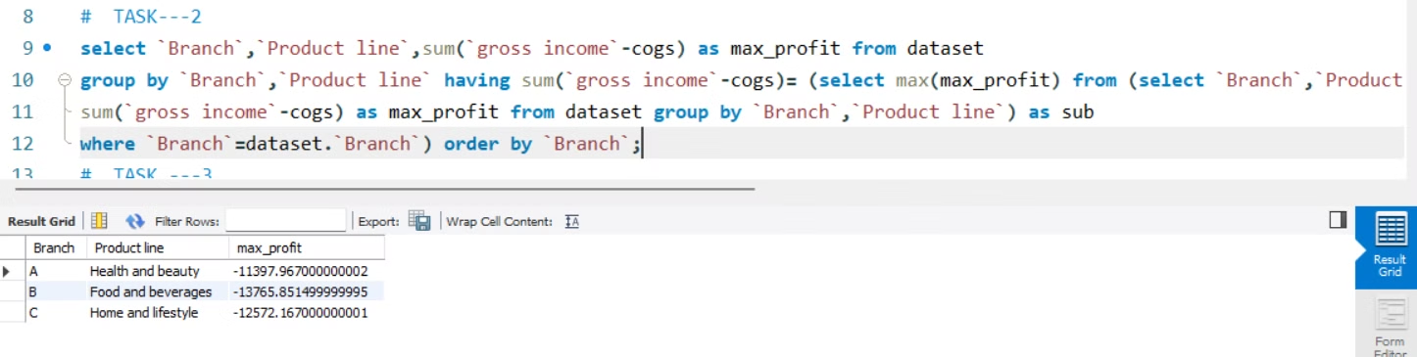
TASK :1 →Top Branch by Sales Growth Rate
Step 1
Step 2
Step 3
Calculate total sales per branch for each month.
Calculate the growth rate between consecutive months.
Identify the branch with the highest growth rate.
TASK :2 →
Most Profitable Product Line per Branch
Step 1
Step 2
Step 3
Calculate profit margin for each transaction.
Calculate total profit per product line.
Identify the product line with the highest profit.

Slide 3



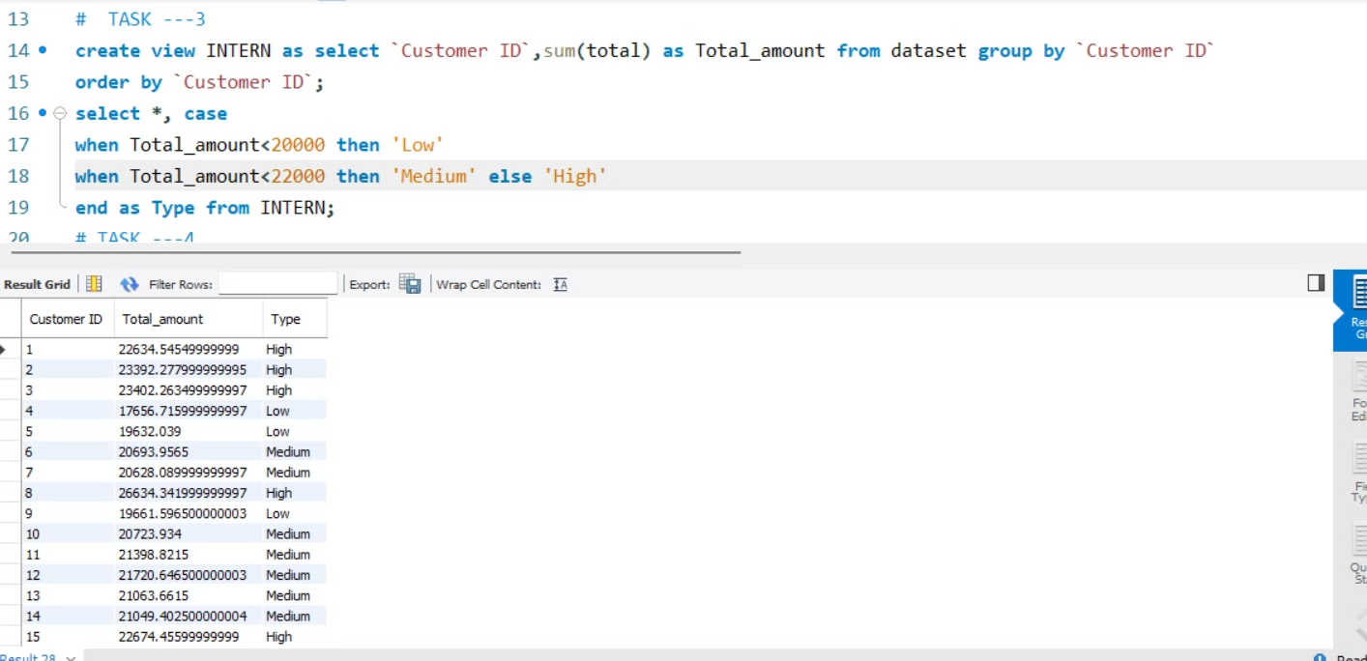
TASK:3→
Customer Segmentation Based on Spending
Step 1
Step 2
Step 3
Calculate total spending for each customer.
Classify customers based on spending thresholds.
Return customer ID and spending segment.

Slide 4
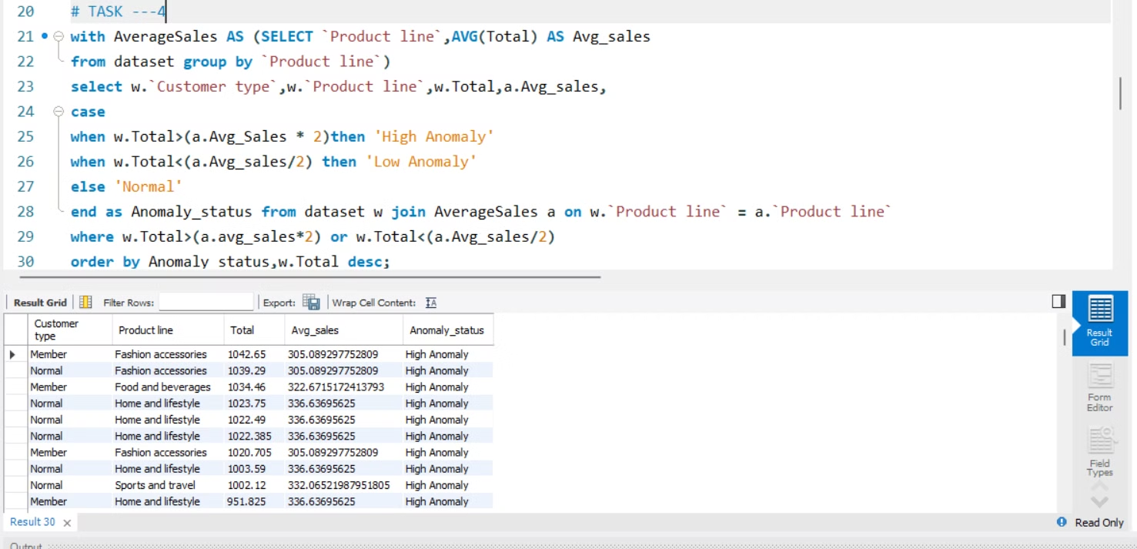
TASK:4→
Detecting Anomalies in Sales Transactions
1
Step 1
Calculate the average and standard deviation of sales.
2
Step 2 :identify transactions with sales significantly above or below average.
3
Step 3
Return the anomalous transactions.

Slide 5



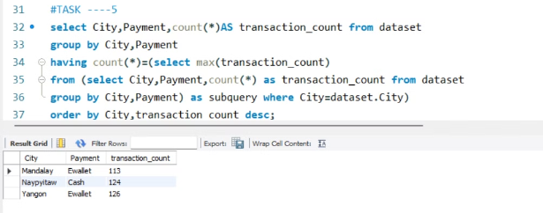

TASK:5→
Most Popular Payment Method by City
Step 1
Group transactions by city and payment method.
Step 2
Calculate the count of each payment method.
Step 3
Identify the most popular payment method.

Slide 6
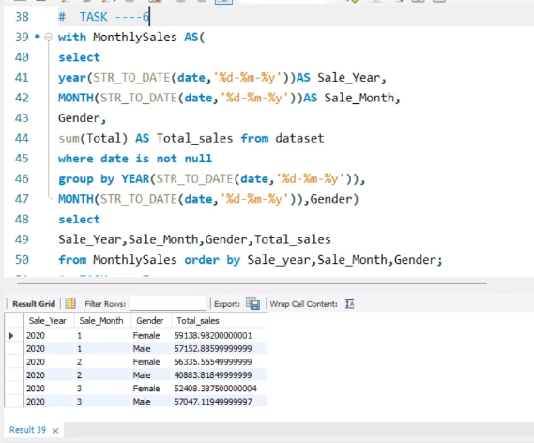
TASK:6→Monthly Sales Distribution by Gender
1
Step 1
Group sales by month and gender.
2
Step 2
Calculate total sales for each gender per month.
3
Step 3
Return total sales by gender for each month.

Slide 7
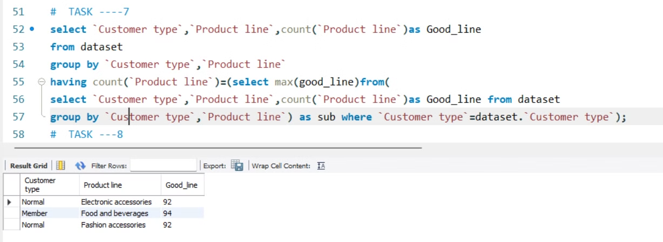
TASK:7→Best Product Line by Customer Type
1
Step 1
Group sales by customer type and product line.
2
Step 2
Calculate total sales for each product line by customer type.
3
Step 3
Identify the best product line for each customer type.

Slide 8



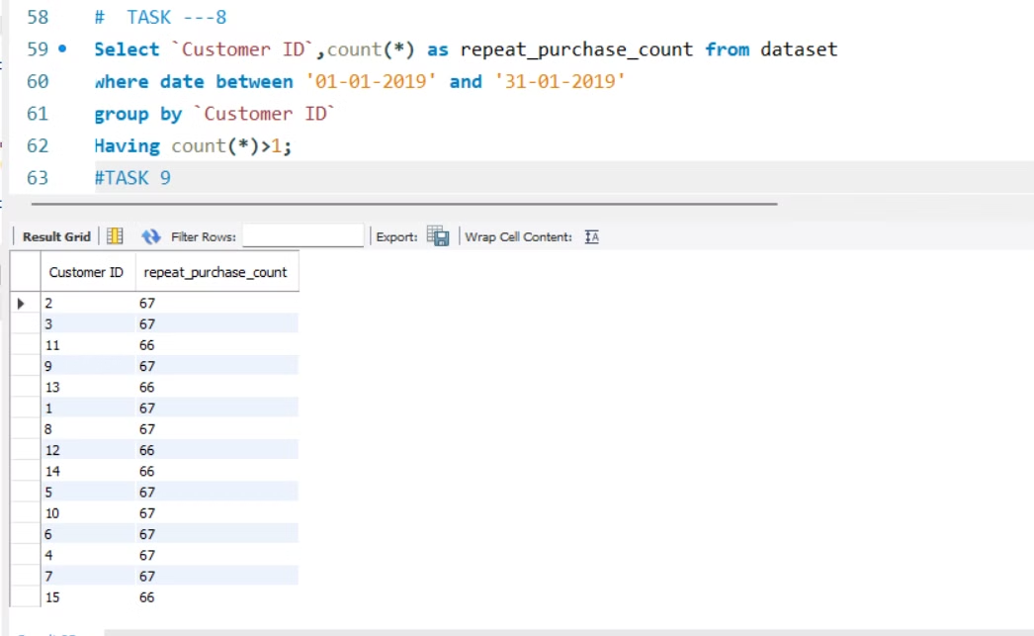
TASK:8→Identifying Repeat Customers
Step 1
Identify transactions for each customer within a specific time frame.
Step 2
Find customers with multiple purchases within the time frame.
Step 3
Return the list of repeat customers.

Slide 9
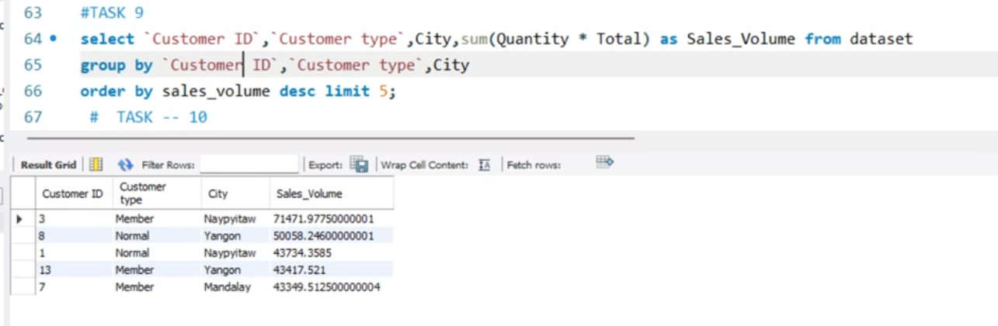
TASK:9→Top 5 Customers by Sales Volume
1
Step 1
Calculate total sales for each customer.
2
Step 2
Sort customers by total sales in descending order.
3
Step 3
Return the top 5 customers with the highest sales.

Slide 10
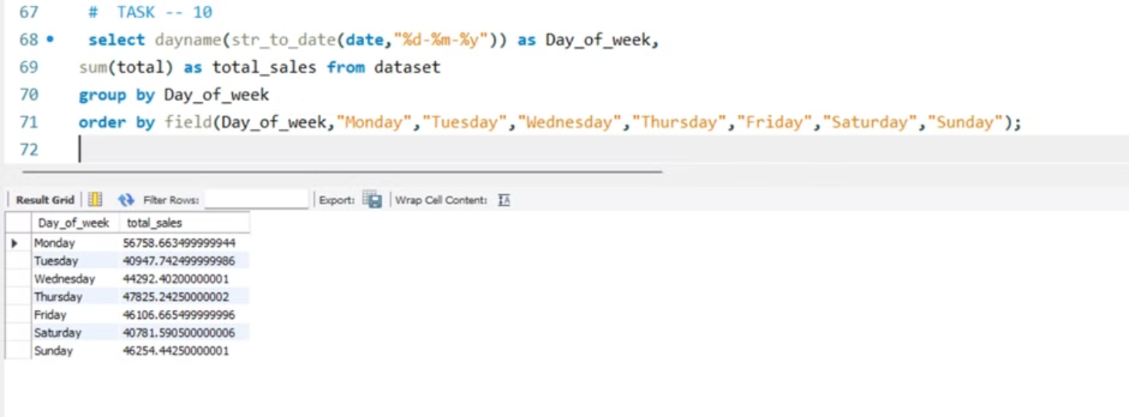
TASK:10→Sales Trends by Day of the Week
Step 1
Step 2
Step 3
Extract the day of the week from the transaction date.
Group total sales by the day of the week.
Return total sales for each day of the week, ordered by day.

Slide 11

Thank you!
We are excited to continue exploring Walmart sales data to uncover valuable insights and drive business success.

